Slide 1
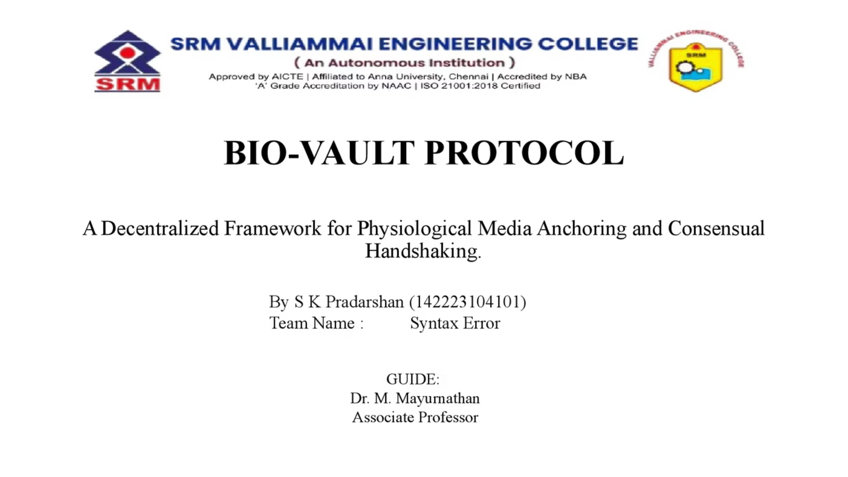

Slide 2
THE PROBLEM
OUR SOLUTION
The Post-Truth Media Crisis
BIO-VAULT PROTOCOL
AI can generate indistinguishable deepfake videos
Metadata can be altered.
Hashes only prove existence, not authenticity
Victims have no way to prove innocence
Consent is not technically enforceable
A three-layer cryptographic system that:
Anchors human physiology to media
Enforces real-time consent
Preserves privacy via zero-knowledge proofs
Key Outputs:
Proof of Presence
Proof of Consent
Legal Exoneration Capability

Slide 3
Literature Review:
1. rPPG & Deep Learning
3. Zero-Knowledge Proofs (Biometrics)
MMPD (Mobile & Real-World Gap): The paper that explicitly states the "gap" regarding mobile phone cameras, lighting, and skin tones.
Tang, J., et al. (2023). "MMPD: Multi-Domain Mobile Video Physiology Dataset.“
Link: IEEE EMBC / arXiv
ZKPs for Biometric Identity: Papers discussing the general application of ZKP to hide biometric templates (the gap is the dynamic signal aspect).
Gunasinghe, H., et al. (2018). "PrivBio: Privacy-Preserving Biometric Authentication Using Zero-Knowledge Proofs.“
Link: IEEE Digital Library (General concept ref)
Note: The specific gap of "ZKPs for continuous rPPG signals" is a novelty of your project, so you cite general ZKP Biometric papers to show the lack of dynamic solutions.
2. Blockchain for Media Authentication
Limitations of Current Blockchain Media Auth: Research discussing how blockchain currently only verifies file integrity (hashing) rather than content authenticity or "Deepfake prevention.“
Hasan, H. R., & Salah, K. (2019). "Combating Deepfake Videos Using Blockchain and Smart Contracts.“
Link: IEEE Access
Also see: Gipp, B., et al. "Securing Video Integrity with Blockchain."

Slide 4
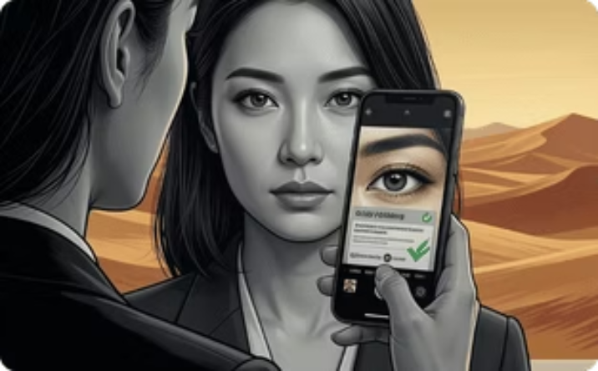

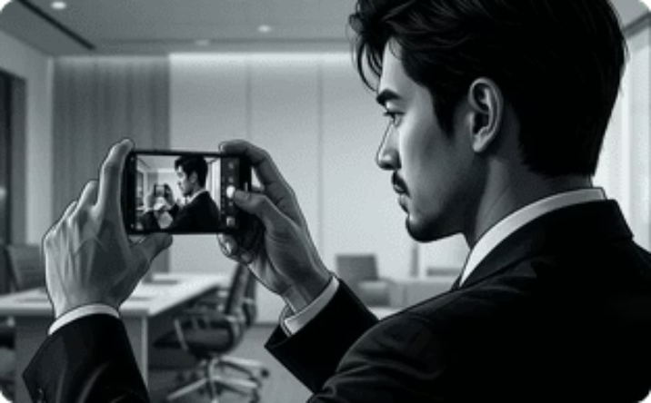
REAL-WORLD SCENARIOS:
Scenario 1: Deepfake Frame-Up
Fake video lacks physiological consistency
Registry check fails
Victim cleared instantly
Scenario 2: Hidden Camera Abuse
No consent handshake
Recorder's device ID + bio-signature anchored
Permanent forensic trail
Scenario 3: Stolen Research / Project Ownership Dispute
Creator's biometric signature is bound to the initial project creation event.
Immutable timestamp shows the project existed under the original creator before the thief's claim.
Version hashes match the original registry entry.
Ownership trail is undeniable.

Slide 5
LAYER A-BIO-SIGNATURE
LAYER B - CONSENSUAL HANDSHAKE
LAYER C — ZERO-KNOWLEDGE PRIVACY
Physiological Identity Binding
Multi-Party Consent Protocol
Privacy-Preserving Legal Verification
AI extracts heartbeat via camera (rPPG)
Signal is time-synchronized with frames
Heartbeat used as cryptographic salt
Salt is never stored in raw form
Recorder + subjects activate Bio-Vault
Devices discover each other via Bluetooth/NFC
Heartbeats synchronized within tolerance window
Multi-signature consensus hash generated
zk-SNARKs prove:
"This video does NOT match my Bio-Signature"
No raw video or biometric data revealed
Courts verify proofs mathematically
Output: Frame-level SHA-256 hashes with biological entropy
Key Insight: Innocence can be proven without exposure.
If handshake fails: Recording is flagged as Unauthorized.

Slide 6









Bio-Vault Protocol Workflow
Initiate Video Capture
Secure Frame Data
Achieve Consensus
Create Proof
Protocol Completion
Zero-knowledge proof is generated to verify authenticity without revealing data
Begin recording video with real-time physiological monitoring
Each video frame is hashed and bound with extracted bio-data
Multiple signatures confirm the integrity of the video and consent
Bio-Vault protocol successfully anchors and authenticates video
Extract Physiological Data
Confirm Consent
Secure Storage
Immutable Record
Participants verify consent through blockchain handshake
Encrypted video is stored off-chain on IPFS or local device
Proof and metadata are stored immutably on the blockchain
AI analyzes video to extract heartbeat and other physiological signals

Slide 7











Components of Bio-Vault Protocol
Device ID
Heart Rate
Timestamp
Unique identifier for the device used
Real-time heart rate of the user
Time of media creation
Frame Index
Nonce
Consensus Hash
Position of the frame in the media
Random number to ensure uniqueness
Hash of the consensus block
rPPG Signal Processor
Consent Manager
Hash Generator
Processes signals from the device
Manages user consent for data usage
Creates cryptographic hashes
ZKP Generator
Blockchain Anchoring Service
Generates zero-knowledge proofs
Anchors media to the blockchain

Slide 8
TECHNICAL ARCHITECTURE AND TECH STACK
AI & Computer Vision
Blockchain
Storage
MediaPipe
OpenCV
Custom rPPG CNN models
Frame synchronization logic
Polygon / Arbitrum (Layer-2)
Smart contracts for:
Consent state
Proof anchoring
Revocation records
IPFS + Filecoin (persistent decentralized storage)
AES-256-GCM encrypted content
Envelope encryption with off-chain key management (KMS / local key vault)
Cryptography
Privacy
SHA-256 (frame hashing)
Multi-signature hashing
TEE (Intel SGX / AMD SEV / ARM TrustZone)
Nonce & timestamp anchorin
zk-SNARKs
Local proof generation
No biometric data on-chain

Slide 9
HOW BIO-VAULT IS DIFFERENT FROM EXISTING SYSTEMS (Novelty analysis)
Aspect
Conventional Systems
BIO-VAULT
What is verified
Verifies the digital file after creation.
Verifies the real-world capture event itself.
Consent
Based on legal text or user declarations.
Proven cryptographically at capture time.
Storage
Stores raw media files.
Stores only cryptographic metadata.
Privacy
Raw data exposure creates privacy risk.
Biological signals are ephemeral and privacy-preserving.
Trust model
Depends on institutions or platforms.
Depends on mathematical proof.
Dispute handling
Requires manual review and arbitration.
Resolved automatically through verification.
Ownership
Claimed after upload and contestable.
Bound to the recorder at capture time.
Tampering
Alterations may go undetected.
Any modification breaks the proof chain.

Slide 10
Key Benefits of BIO-VAULT
1
Authentic Event Verification
2
Cryptographically Proven Consent
3
Enhanced Privacy
Stores only cryptographic metadata, ensuring biological signals are ephemeral and privacy-preserving.
Verifies the real-world capture event itself, not just the digital file after creation.
Consent is proven cryptographically at capture time, eliminating reliance on legal text or user declarations.
4
Mathematical Proof of Trust
5
Tamper-Proof Integrity
The trust model depends on mathematical proof, not on institutions or platforms.
Any modification to the data breaks the proof chain, ensuring alterations are immediately detected.

Slide 11
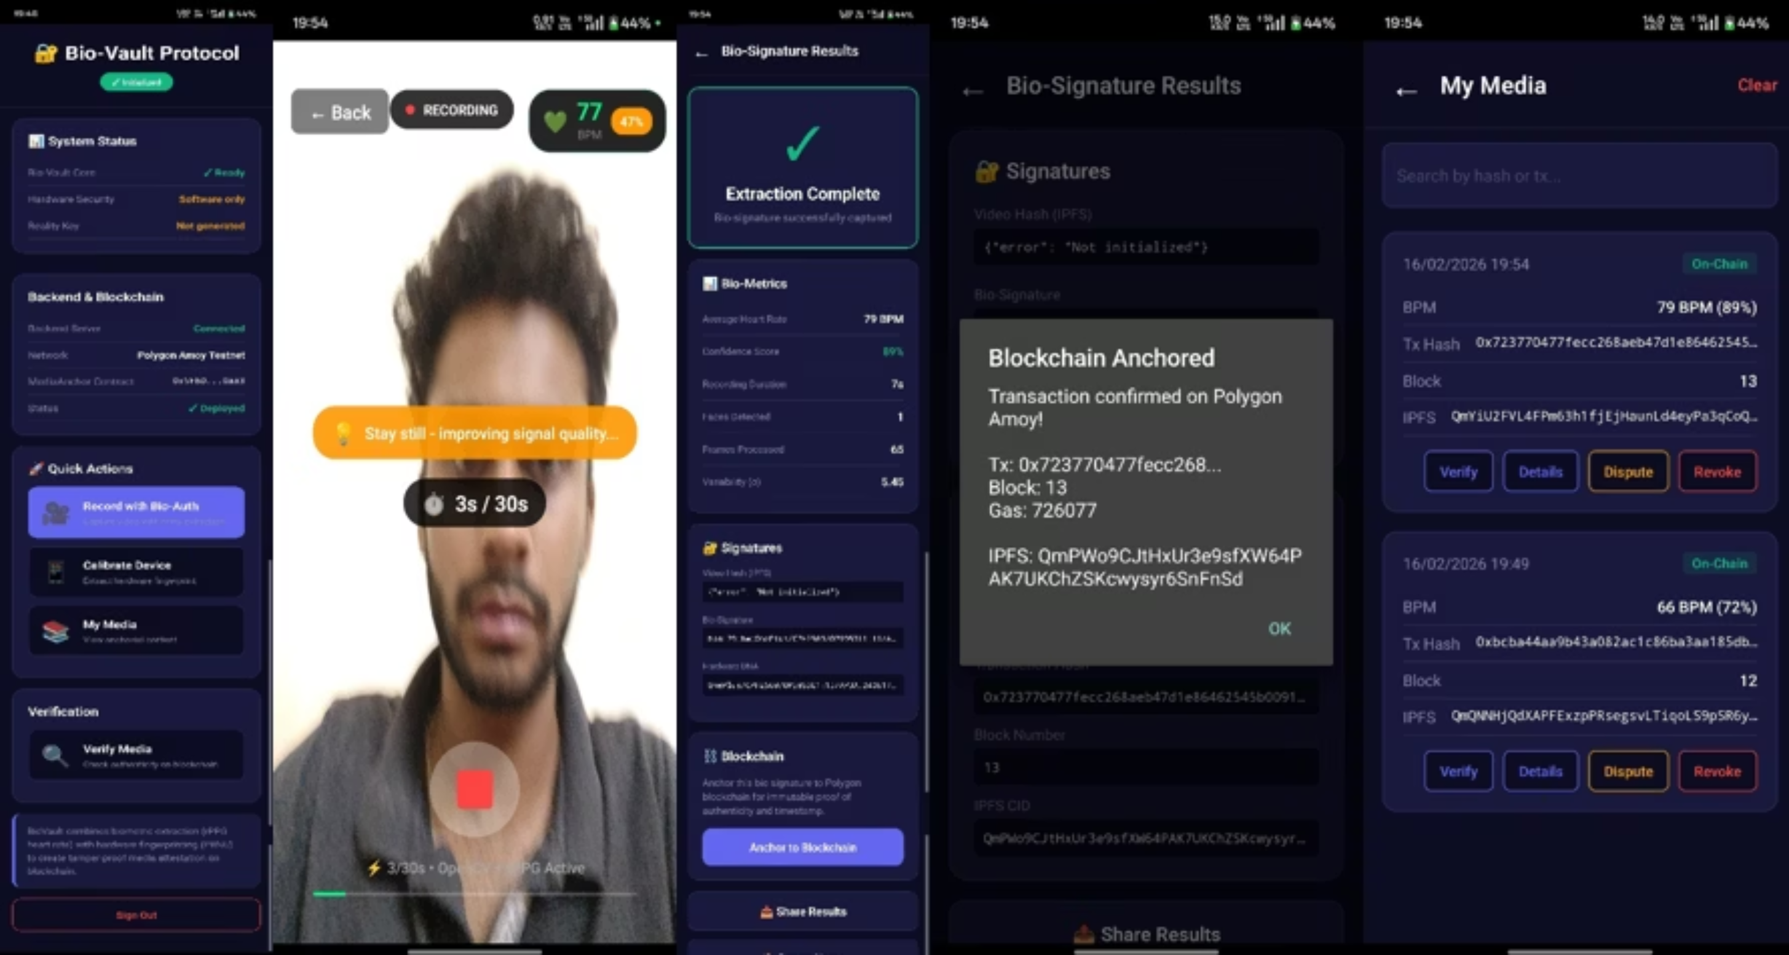
Prototype output :

